Slide 1






Tools and Lab
Results
Conclusion
Research Question

Slide 2




Research Question

Slide 3

What’s QUIC?
"Quick UDP Internet Connections“ _____________________________________
QUIC improves performance of connection-oriented web applications that are currently using TCP. It does this by establishing a number of multiplexed connections between two endpoints over User Datagram Protocol (UDP).

Slide 4

Why it’s Interesting?
We have been using QUIC unconsciously for several years now.
Google Corporation and some recent research claim that QUIC has reduced the latency of Google search responses by 3.6% and YouTube video repositories by 15.3%.
Google has a clear motive for promoting the QUIC protocol and is very hard to resist.
The studies produce biased results, especially those that Google wants us to be exposed to.

Slide 5
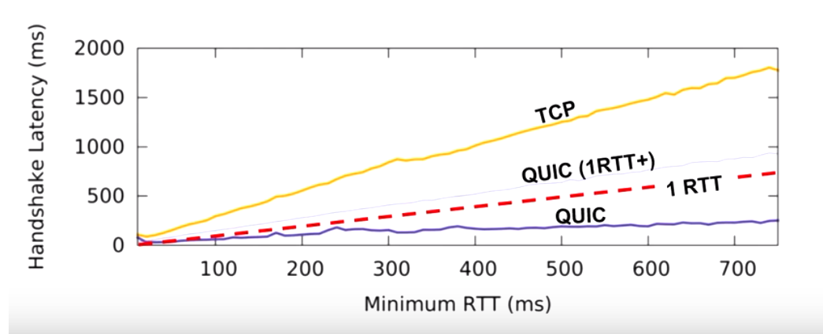
Knowledge
Related work.. TBD….

Slide 6



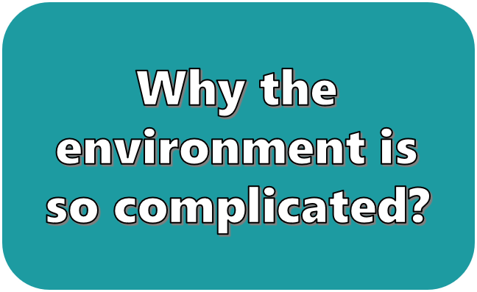
Tools and Lab

Slide 7

Why the environment is so complicated?
gQUIC protocol that implements by Google working only on a Google client (Chrome) and servers (still no use for IETF QUIC - iQUIC )
QUIC open source getting update constantly and doesn’t necessarily equal to the gQUIC.
QUIC protocol using TLS1.3 – all the connections through the tests should be secured with certificates.
The test scenario should be equal with HTTP2.0 for comparation.

Slide 8
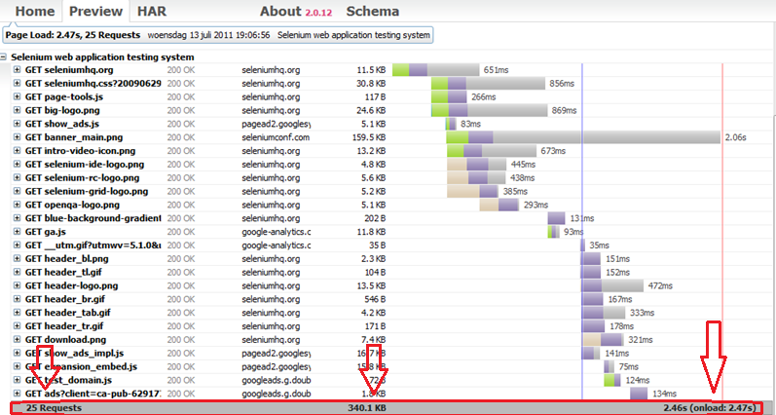
.HAR file:
The HTTP Archive format, or HAR, is a JSON-formatted archive file format for logging of a web browser's interaction with a site. The common extension for these files is .HAR.

Slide 9

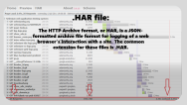
Our lab & tools:
We measure 3 things in every entry (through :
Number of requests
Total weight
Total time
After verifying that the browser use the QUIC protocol only when set in the profile configuration, we looked at 3 test cases:
1. Run on a virtual machine with WiFi connection
2. Run on a virtual machine with an Ethernet connection
3. Run on Linux with an Ethernet connection
In each test case we made 500 entries to Google server (YouTube) using the QUIC protocol and 500 identical entries without the experimental protocol (using HTTP 2.0)

Slide 10

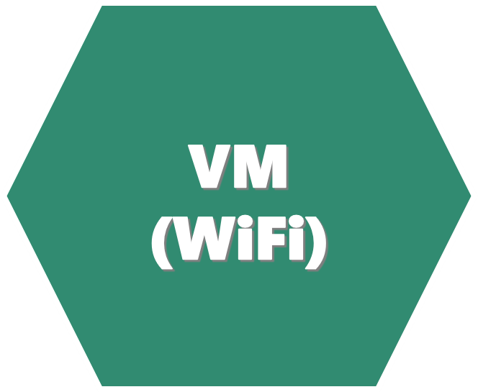
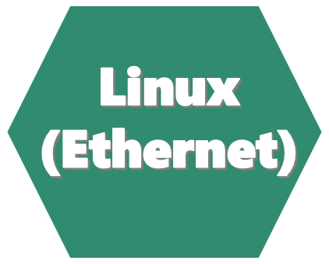
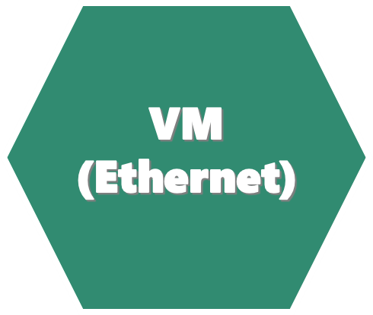
RESULTS

Slide 11
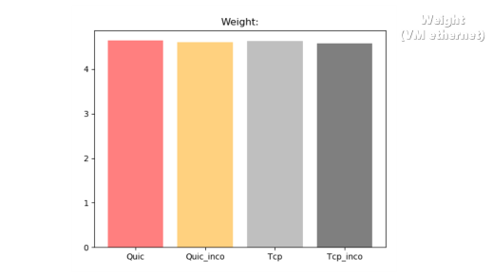
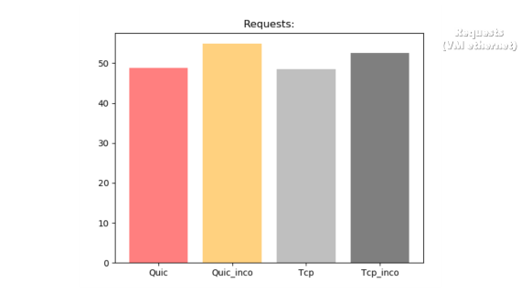
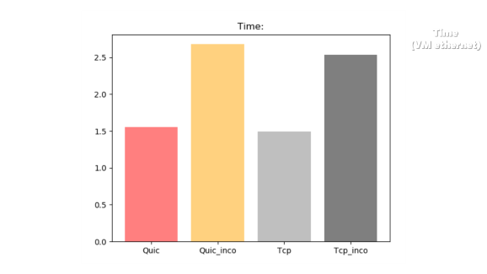
VM (Ethernet)
Weight
Time
Requests

Slide 12
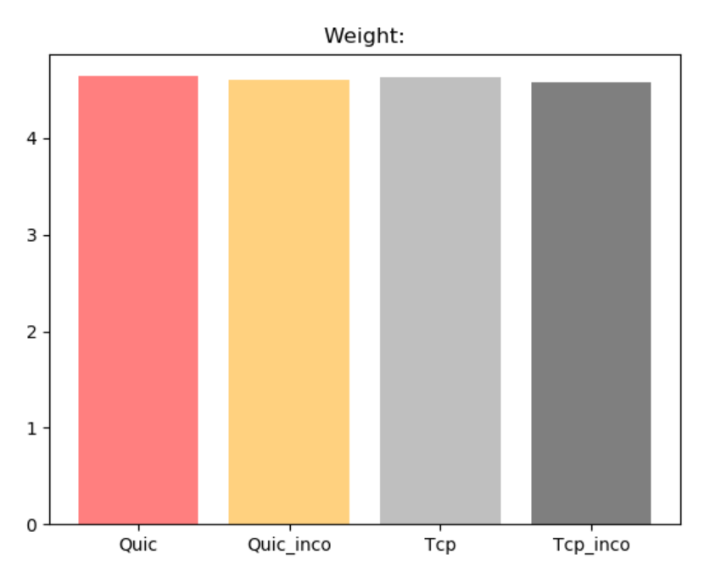
Weight
(VM ethernet)

Slide 13
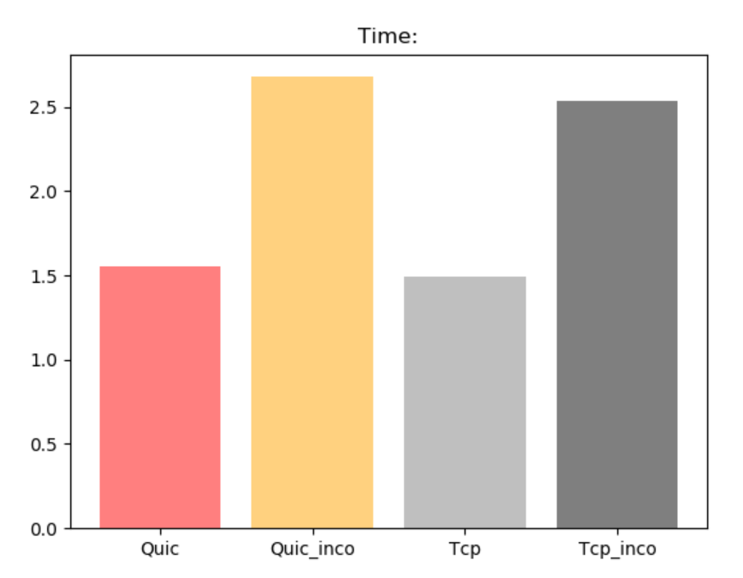
Time
(VM ethernet)

Slide 14
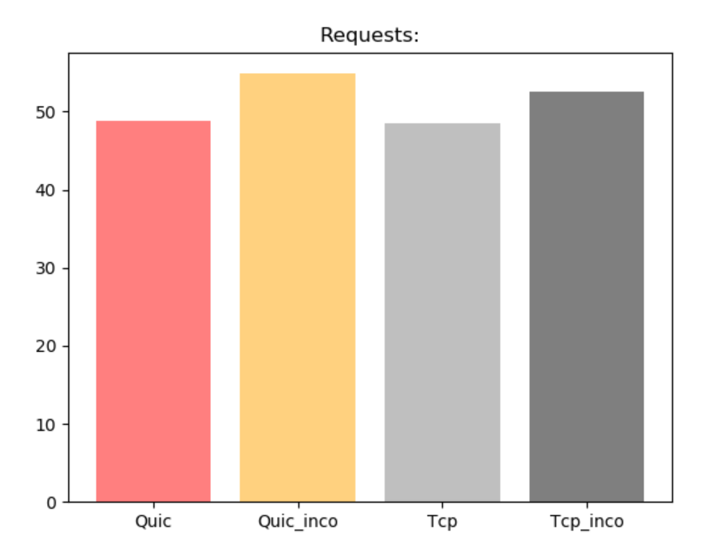
Requests
(VM ethernet)

Slide 15
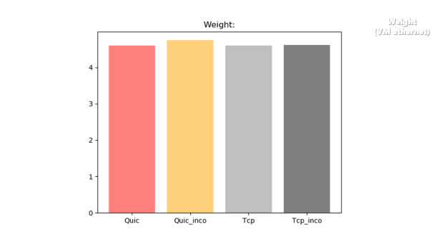
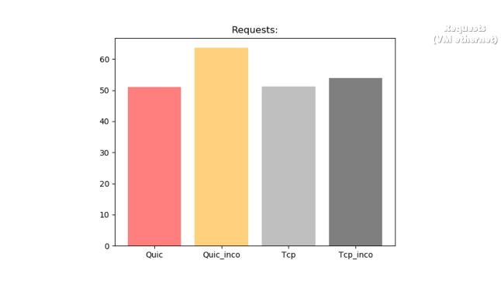
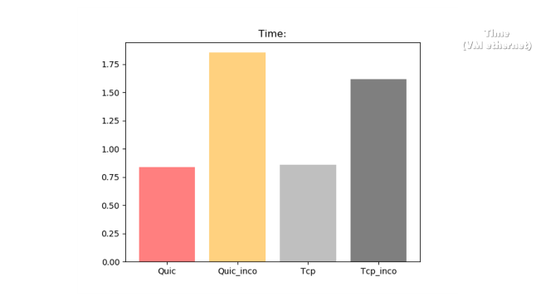
Linux (Ethernet)
Weight
Time
Requests

Slide 16
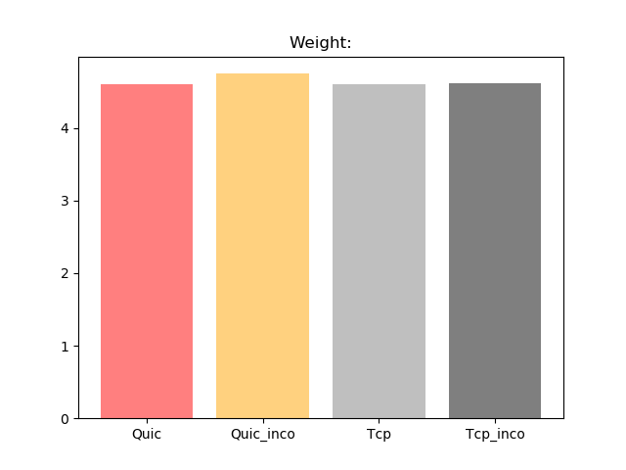
Weight
(VM ethernet)

Slide 17
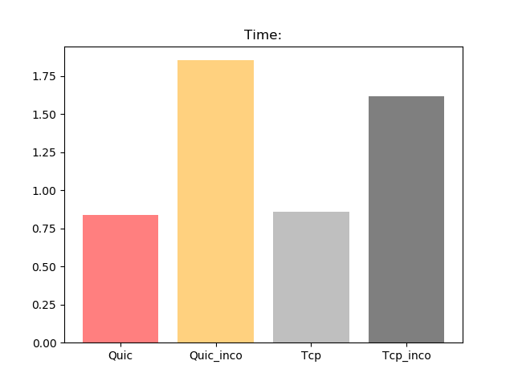
Time
(VM ethernet)

Slide 18
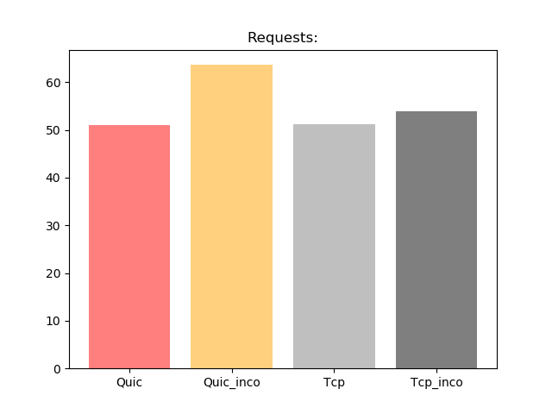
Requests
(VM ethernet)

Slide 19
VM (WiFi)
Weight
Time
Requests

Slide 20
Weight
(VM ethernet)

Slide 21
Time
(VM ethernet)

Slide 22
Requests
(VM ethernet)

